Slide 1

LECTURE 3: Requirements Engineering
Instructor: Maria Striki
Rutgers University
Presentation: Ivan Marsic, Maria Striki
Rutgers University
Notes:
http://office.microsoft.com/clipart/default.aspx

Slide 2
Topics
Requirements Engineering Components
Requirements and User Stories
Types of Requirements
Effort Estimation (Agile Methods)

Slide 3
Software Development Methodologies
Structured Analysis and Design (SAD), in late ‘60s and ‘70s: key modeling tools are functional decomposition and data-flow analysis.
Object-oriented Analysis and Design (OOAD), in late ‘80s and ‘90s: key modeling tools are UML and use cases.
Agile Software Development (ASD), in late ‘90s and 2000s: “lightweight” way to develop software.
Aspect-oriented Software Development (AOSD), in 2000s: helps deal with scattered crosscutting concerns systematically.

Slide 4
Agile Development
Agile: philosophy and a collection of concepts embedded into development methodologies…………………………………………………………………………………key modeling tools are functional decomposition and data-flow analysis.
Object-oriented Analysis and Design (OOAD), in late ‘80s and ‘90s: key modeling tools are UML and use cases.
Agile Software Development (ASD), in late ‘90s and 2000s: “lightweight” way to develop software.
Aspect-oriented Software Development (AOSD), in 2000s: helps deal with scattered crosscutting concerns systematically.

Slide 5
Requirements Process
Aspect-Oriented Requirements
Object-Oriented Analysis & Design
Requirements gathering
Requirements analysis
Requirements specification
Structured Analysis & Design
Agile Development User Stories

Slide 6
Requirements Engineering Components
Requirements gathering
  (a.k.a. “requirements elicitation”) helps the customer to define what is required: what is to be accomplished, how the system will fit into the needs of the business, and how the system will be used on a day-to-day basis
Requirements analysis
  refining and modifying the gathered requirements
Requirements specification
  documenting the system requirements in a semiformal or formal manner to ensure clarity, consistency, and completeness

Slide 7
Requirements and Specification
Problem domain
Software (Solution) domain
Describes
Requirements
Specifi
cation
Program
Customer
Specifies
Analyzes
Develops
Software Engineer

Slide 8
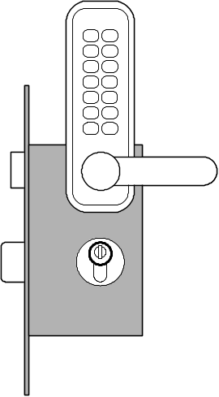
Example System Requirements
Identifier | Priority | Requirement
REQ1 | 5 | The system shall keep the door locked at all times, unless commanded otherwise by authorized user. When the lock is disarmed, a countdown shall be initiated at the end of which the lock shall be automatically armed (if still disarmed).
REQ2 | 2 | The system shall lock the door when commanded by pressing a dedicated button.
REQ3 | 5 | The system shall, given a valid key code, unlock the door and activate other devices.
REQ4 | 4 | The system should allow mistakes while entering the key code. However, to resist “dictionary attacks,” the number of allowed failed attempts shall be small, say three, after which the system will block and the alarm bell shall be sounded.
REQ5 | 2 | The system shall maintain a history log of all attempted accesses for later review.
REQ6 | 2 | The system should allow adding new authorized persons at runtime or removing existing ones.
REQ7 | 2 | The system shall allow configuring the preferences for device activation when the user provides a valid key code, as well as when a burglary attempt is detected.
REQ8 | 1 | The system should allow searching the history log by specifying one or more of these parameters: the time frame, the actor role, the door location, or the event type (unlock, lock, power failure, etc.). This function shall be available over the Web by pointing a browser to a specified URL.
REQ9 | 1 | The system should allow filing inquiries about “suspicious” accesses. This function shall be available over the Web.
Problem: Requirements prioritization.
See how solved in agile methods.

Slide 9
User Stories
As a tenant, I can unlock the doors to enter my apartment.
user-role
(benefactor)
capability
business-value
Similar to system requirements, but focus on the user benefits, instead on system features.
Preferred tool in agile methods.

Slide 10
Example User Stories
Identifier | User Story | Size
ST-1 | As an authorized person (tenant or landlord), I can keep the doors locked at all times. | 4 points
ST-2 | As an authorized person (tenant or landlord), I can lock the doors on demand. | 3 pts
ST-3 | The lock should be automatically locked after a defined period of time. | 6 pts
ST-4 | As an authorized person (tenant or landlord), I can unlock the doors. (Test: Allow a small number of mistakes, say three.) | 9 points
ST-5 | As a landlord, I can at runtime manage authorized persons. | 10 pts
ST-6 | As an authorized person (tenant or landlord), I can view past accesses. | 6 pts
ST-7 | As a tenant, I can configure the preferences for activation of various devices. | 6 pts
ST-8 | As a tenant, I can file complaint about “suspicious” accesses. | 6 pts

Slide 11
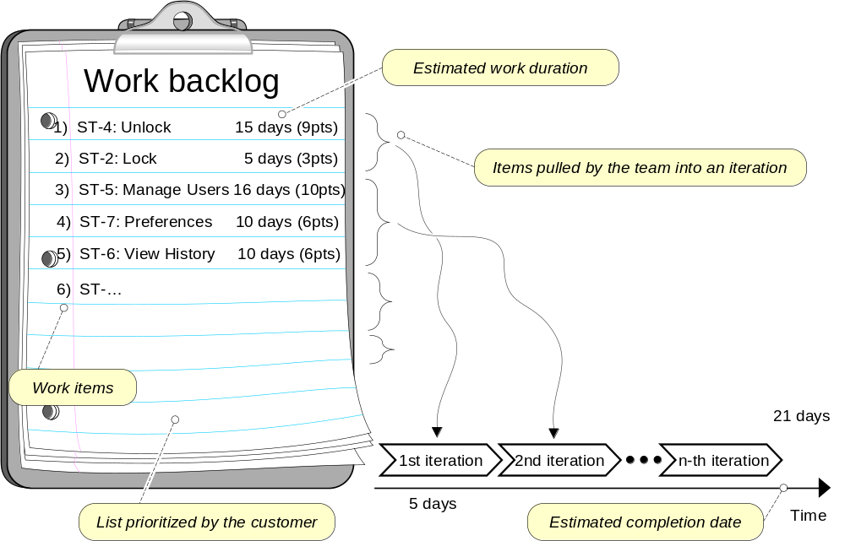
Dynamic Prioritization of User Stories

Slide 12
Types of Requirements
Functional Requirements
Non-functional requirements
  FURPS+
  Functionality (security), Usability, Reliability, Performance , Supportability
On-screen appearance requirements

Slide 13
On-screen Appearance Requirements
Do not waste your time and your customer’s time by creating elaborate screen shots with many embellishments, coloring, shading, etc., that serves only to distract attention from most important aspects of the interface
Hand-drawing the proposed interface forces you to economize and focus on the most important features
Only when there is a consensus that a good design is reached, invest effort to prototype the interface

Slide 14
Tools for Requirements Eng.
Tools, such as user stories and use cases,
used for:
  Determining what exactly the user needs (“requirements analysis”)
  Writing a description of what system will do (“requirements specification”)
Difficult to use the same tool for different tasks (analysis vs. specification)

Slide 15
Acceptance Tests
Means of assessing that the requirements are met as expected
Conducted by the customer
An acceptance test describes whether the system will pass or fail the test, given specific input values
Cannot ever guarantee 100% coverage of all usage scenarios, but systematic approach can increase the degree of coverage

Slide 16
Project Estimation using User Story Points
Similar to “hedge pruning points” in the first lecture
Points assigned to individual user stories
Total work size estimate:
  Total size = Σ points-for-story i (i = 1..N)
Velocity (= productivity) estimated from experience
Estimate the work duration
Project duration =
Path size
Travel velocity

Slide 17
Example User Stories
Identifier | User Story | Size
ST-1 | As an authorized person (tenant or landlord), I can keep the doors locked at all times. | 4 points
ST-2 | As an authorized person (tenant or landlord), I can lock the doors on demand. | 3 pts
ST-3 | The lock should be automatically locked after a defined period of time. | 6 pts
ST-4 | As an authorized person (tenant or landlord), I can unlock the doors. (Test: Allow a small number of mistakes, say three.) | 9 points
ST-5 | As a landlord, I can at runtime manage authorized persons. | 10 pts
ST-6 | As an authorized person (tenant or landlord), I can view past accesses. | 6 pts
ST-7 | As a tenant, I can configure the preferences for activation of various devices. | 6 pts
ST-8 | As a tenant, I can file complaint about “suspicious” accesses. | 6 pts

Slide 18
Agile Estimation of Project Effort
1) Prune Section 6 1 day (2pts)
2 points per day
1 = 4 pts (2 days)
2 = 7 pts (3.5 days)
3 = 10 pts (5 days)
4 = 3 pts (1.5 days)
5 = 4 pts (2 days)
6 = 2 pts (1 day)
7 = 4 pts (2 days)
8 = 7 pts (3.5 days)
2) Prune Section 5 2 days (4pts)
3) Prune Section 7 2 days (4pts)
4) Prune Section 4 1.5 days (3p)
5) Prune Section 8 3.5 days (7p)
Work backlog
Estimated work duration
1) ST-4: Unlock 15 days (9pts)
2) ST-2: Lock 5 days (3pts)
Items pulled by the team into an iteration
3) ST-5: Manage Users 16 days (10pts)
4) ST-7: Preferences 10 days (6pts)
5) ST-6: View History 10 days (6pts)
6) ST-…
Work items
21 days
1st iteration
2nd iteration
n-th iteration
List prioritized by the customer
5 days
Estimated completion date
Time

Slide 19
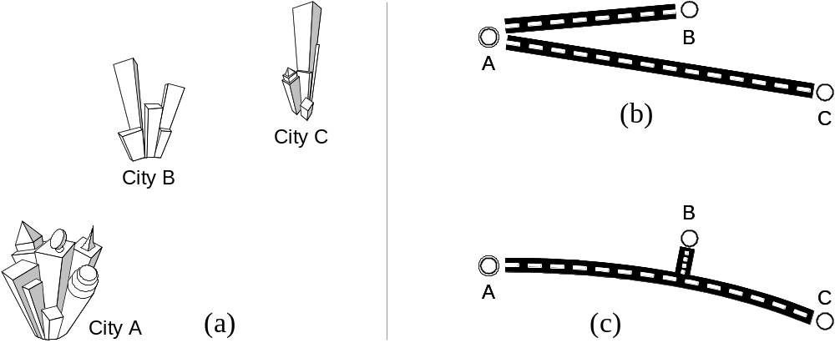
How To Combine the Part Sizes?
Costs are not always additive
But, solution (c) is not necessarily “cheaper” than (b) …

Slide 20
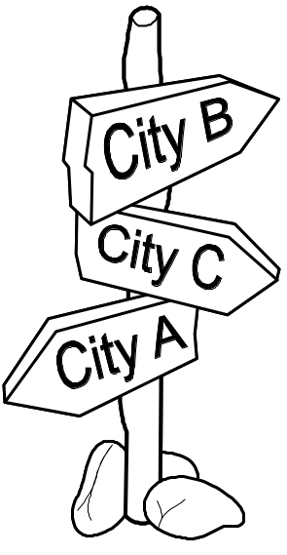

Additional Costs
Highway traffic-circle interchange
Traffic signs

Slide 21
Software Process Activities
Software specification, where customers and engineers define the software that is to be produced and the constraints on its operation.
Software development, where the software is designed and programmed.
Software validation, where the software is checked to ensure that it is what the customer requires.
Software evolution, where the software is modified to reflect changing customer and market requirements.

Slide 22
General Issues that affect Software (1)
Heterogeneity
  Increasingly, systems are required to operate as distributed systems across networks that include different types of computer and mobile devices.
Business and social change
  Business and society are changing incredibly quickly as emerging economies develop and new technologies become available. They need to be able to change their existing software and to rapidly develop new software.

Slide 23
General Issues that affect Software (2)
Security and trust
  As software is intertwined with all aspects of our lives, it is essential that we can trust that software.
Scale
  Software has to be developed across a very wide range of scales, from very small embedded systems in portable or wearable devices through to Internet-scale, cloud-based systems that serve a global community.

Slide 24
Software Engineering fundamentals
Some fundamental principles apply to all types of software system, irrespective of the development techniques used:
  Systems should be developed using a managed and understood development process. Of course, different processes are used for different types of software.
  Dependability and performance are important for all types of system.
  Understanding and managing the software specification and requirements (what the software should do) are important.
  Where appropriate, you should reuse software that has already been developed rather than write new software.

